Slide 1



The fabulous G5
Javi Ansoleaga
Mónia Gomes
Karthikeyan Karuppusamy

Slide 2
Executive summary
Accuracy Achieved: 0.9264
Final model: SVM
Alternative models: Logistic Regression, Naive Bayes, XGB Classifier
Vectorization methods: Word2Vec, BoW and TD-IDF
Pre-processing steps tried: Cleaning, Tokenization, Lemmatization, and StopWords removal
Notes:
KK

Slide 3
Methods
Notes:
JA
Model Performance: SVM and Logistic Regression generally provide higher accuracy across all preprocessing techniques compared to Naive Bayes and XGBoost.
Impact of Preprocessing: Applying cleaning, tokenization, and lemmatization improves performance slightly, but these improvements are model and task-dependent. Preprocessing like stopword removal had minimal impact on accuracy compared to other steps.
Bag of Words vs. TF-IDF: show similar performance across most models, with slight variations in accuracy.

Slide 4
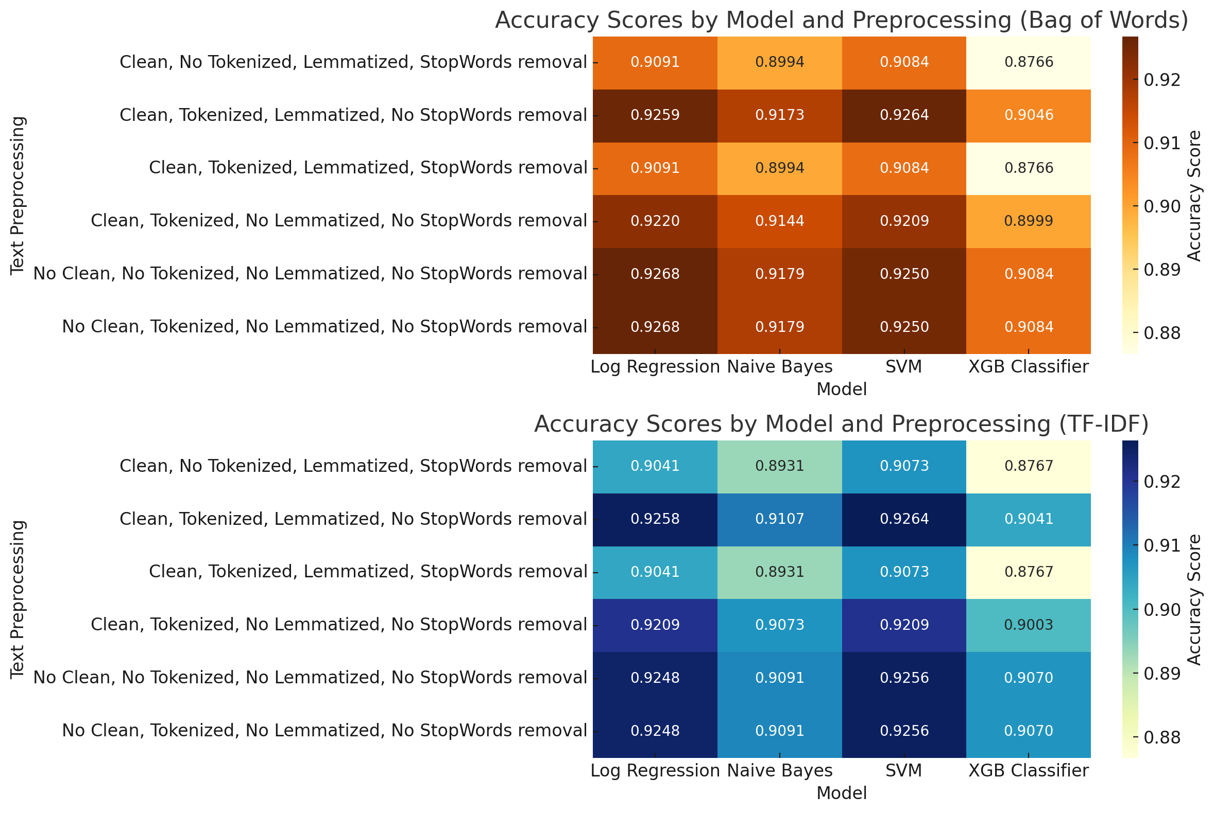
Methods
Notes:
MG
Model Performance: SVM and Logistic Regression generally provide higher accuracy across all preprocessing techniques compared to Naive Bayes and XGBoost.
Impact of Preprocessing: Applying cleaning, tokenization, and lemmatization improves performance slightly, but these improvements are model and task-dependent. Preprocessing like stopword removal had minimal impact on accuracy compared to other steps.
Bag of Words vs. TF-IDF: show similar performance across most models, with slight variations in accuracy.

Slide 5
Testing vs Validation accuracy
Predicted Accuracy for the Testing Data Set is : 0.9264

Slide 6
Takeaways
Challenges: Being able to identify where to focus during testing (Model selection, Pre-processing, Hyperparameters, etc.).
Conclusion : One size does not fit all!
Notes:
JA
The preprocessing step that had the most significant impact on improving accuracy was cleaning and tokenization.
Key Points:
Cleaning and Tokenization resulted in noticeable improvements across most models, particularly for Logistic Regression and SVM.
Lemmatization and Stopwords removal had a smaller, more task-dependent impact. In some cases, they provided minor boosts in accuracy, but the improvements were not as consistent.
Thus, cleaning and tokenization tend to be the most effective preprocessing steps for enhancing model accuracy in text classification tasks.

Slide 7
Instructions
All team members must participate (either split the slides, or discuss the part that you did for each slide)
7 minutes for presentation (HARD limit) + 3 minutes for questions
Tip: Rehearse the presentation at least once
Submit: code + ppt on a github repo
Deadline: Friday 11:30. Presentations will start around that time so we have a 30-min buffer to account for technical issues
Each student must submit their own repo to the Ironhack portal
Group members may submit the same files – but each on their own repo

